Slide 1
Interdisciplinary Collaboration to Optimize Patient Outcomes:
The Integral Role of the DNP
Jane Jeffrie Seley, DNP, MPH, BC-ADM, CDE
Diabetes Nurse Practitioner
NewYork-Presbyterian/ Cornell
janeseley@nyp.org
2012 Acute Care NP/PA Leadership Summit
September 20, 2012

Slide 2
What is a Doctor of Nursing Practice Degree?
Doctor of Nursing Practice (DNP) is a clinical doctorate that includes the study of:
Evidence based practice
Organizational & Systems Leadership
Information Technology
Healthcare Policy & Advocacy
Interprofessional collaboration across disciplines
Chism, LA (2012). The Doctor of Nursing Practice: A guidebook for Role Development and Professional Issues. Jones & Bartlett: Burlington, MA.

Slide 3
Why DNP vs. PhD???
DNP | PhD
Practice Focused terminal degree | Research Focused terminal degree
Curriculum places emphasis on clinical practice | Curriculum places emphasis on theory & research methodology
Final scholarly project: May be evidence based practice or research project based on clinical practice and how research impacts on practice | Final scholarly project: includes dissertation that requires the development of new knowledge
*DNP research projects may generate new knowledge related to clinical practice

Slide 4
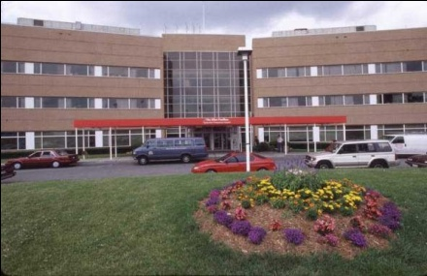


Meeting the Glycemic Challenge at NYPH
2,192 beds
110,000 discharges annually
4,700 Physicians & 4,900 Nurses
16,000 Employees at 4 campuses
How does the DNP have the greatest impact?

Slide 5

Using Strategies that Succeed
Optimizing Diabetes Meal Plans
Automating Insulin Dosing
Utilizing Blood Glucose Data
Patient & Professional Education
Care Coordination Across Settings AND SITES

Slide 6


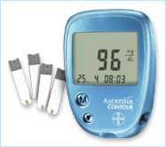




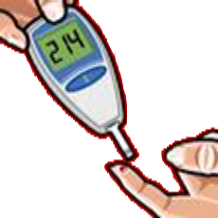
Timing is Everything!

Slide 7
Management of Hyperglycemia in Hospitalized Patients in Non-Critical Care Setting: An Endocrine Society Clinical Practice Guideline (2012). J Clin Endocrinol Metab 97: 16–38.
Sponsors: Endocrine Society, American Diabetes Association, American Heart Association, American Association of Diabetes Educators, European Society Of Endocrinology & Society of Hospital Medicine
Task Force: Umpierrez, GE; Hellman, R; Korytkowski, M; Kosiborod, M; Maynard, G; Montori, VM, Seley, JJ; Van den Berghe, G.

